Slide 1

Education
University
Wuling Tweet Sentiment Analysis
www.website.com

Slide 2

Information about Dataset
Education
University
01
Sample Size
This dataset contains 334 tweets
02
Language
The tweet language that we scrapped is in indonesian
03
Date
The tweet date that we scrapped is from 18th April 2024 until 2nd May 2024
03
Stopwords used
nabrak, sayaa, wuling, biru, kucing, gw, gua, gue, lah, yg, kpala, suku
www.website.com

Slide 3
Education
University
Sentiment Analysis Process
1st
2nd
3rd
4th
Data Scraping
Data Preprocessing
Auto Sentiment Analysis
Wordcloud, Bi-Gram and Google Gemini Analysis
Scrape the twitter data using tweet harvest. In this case, I scraped with total of 334 tweet data from 18th April until 2nd May 2024 with “wuling” keyword
Some Data Preprocessing method that used to clean the text are : removing links, number, symbol, emoticons, and removing Indonesian stopwords using Sastrawi
Do Auto Sentiment Analysis on the cleaned text with Bert-Indo. There are 3 sentiments : Positive, Neutral and Negative
Lastly, Analyze for each sentiments with Wordcloud and Bi-Gram Analysis and for each Wordcloud and Bi-Gram there are Google Gemini’s conclusion and actionable insight based on the chart

Slide 4
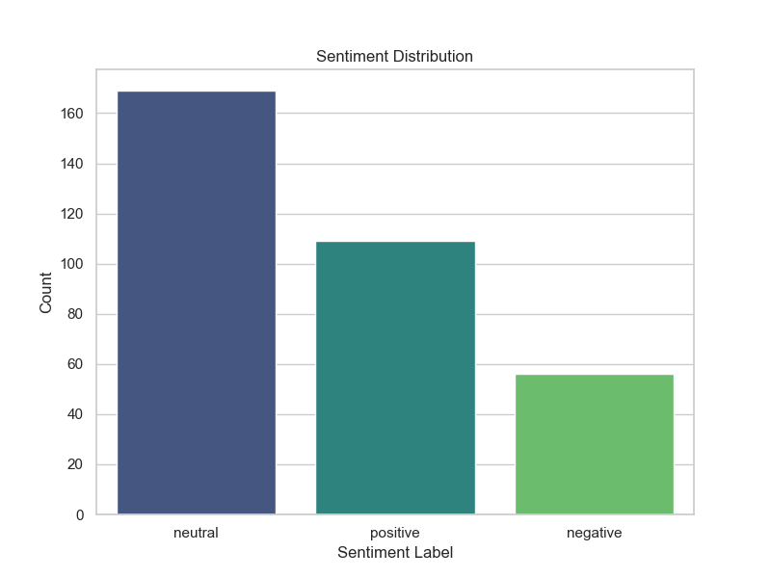
Education
Amount of each Sentiment

Slide 5
Amount of each Sentiment
Education

Slide 6
Education
University
01
Negative Sentiment

Slide 7
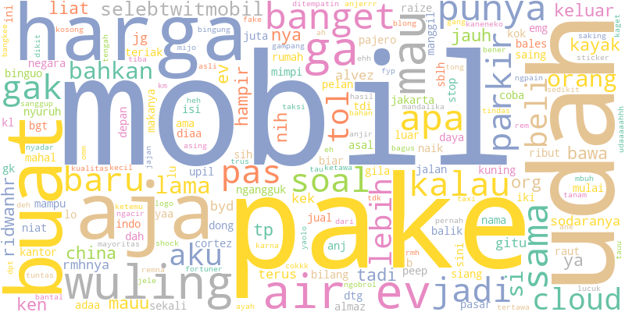
Education
Negative Sentiment Wordcloud

Slide 8
Conclusion based on the Negative Sentiment Wordcloud :
Consumers express frustration with the lack of transparency in pricing.
There's a prevalent perception that car salespeople are dishonest and untrustworthy.
Consumers feel they are not receiving fair deals when purchasing cars.
The car-buying process is perceived as excessively time-consuming and stressful.
Concerns arise regarding the quality and safety of used cars.
Consumers express worries about the environmental impact of cars.

Slide 9
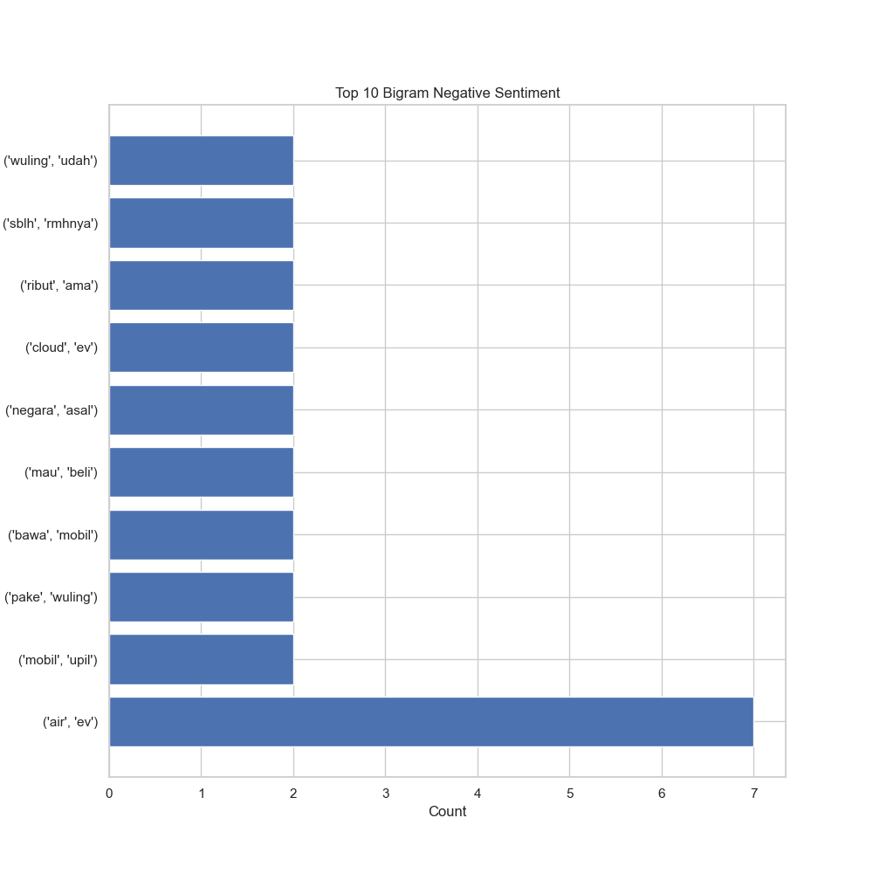
Education
Negative Sentiment Bi-Gram Analysis

Slide 10
Actionable insights that could be derived from these conclusions are:
Consumers express negative sentiments toward the brand "Wuling Motors" (terkait "wuling udah").
There's a negative perception of the brand regarding "one side" and "one of them" (terkait "sblh" and "mhnya").
Negative comments are associated with "fight" and "with" (ribut ama).
"Cloud EV" (cloud ev) is another bigram with negative consumer sentiment.
The brand's association with "country" and "origin" (terkait "negara" and "asal") also has negative bigram sentiment.
Consumers have negative feelings toward "want" and "buy" (mau beli).
Negative sentiment is observed in the bigram "bring" and "car" (bawa mobil).
"Use" and "Wuling" (pake wuling) is another bigram with negative consumer sentiment.
The brand's association with "car" and "lousy" (terkait "mobil" and "upil") has negative bigram sentiment.
Consumers hold negative sentiments toward the brand's association with "air" and "EV" (terkait "air" and "ev").

Slide 11
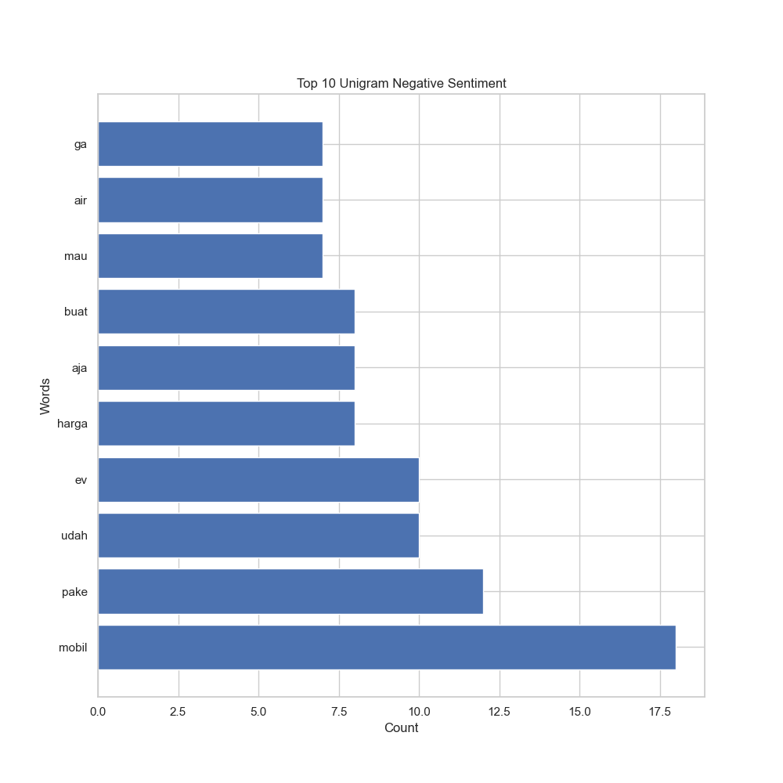
Education
Negative Sentiment Uni-Gram Analysis

Slide 12
Actionable insights that could be derived from these conclusions are:
The chart reveals the top 10 unigrams associated with negative sentiment, offering valuable insights for shaping marketing strategies. The words with the highest negative sentiment include "mobil" (car), "pake" (use), "udah" (already), "ev" (electric vehicle), "harga" (price), "aja" (just), "buat" (for), "mau" (want), "air" (water), and "ga" (not).
These negative sentiments may arise from various factors such as economic conditions, product quality, or customer service. To address these concerns effectively, businesses can take targeted actions:
Improving Vehicle Quality: Address negative sentiment towards "mobil" and "pake" by enhancing the quality and durability of vehicles, ensuring positive customer experiences during purchases and maintenance.

Slide 13
Actionable insights that could be derived from these conclusions are:
Reviewing Pricing Strategies: Address negative sentiment towards "udah", "ev", and "harga" by reviewing pricing strategies, offering competitive deals, and providing discounts where applicable.
Clarifying Product Benefits: Address negative sentiment towards "aja" and "buat" by clearly communicating the product's intended purpose and highlighting its benefits more effectively.
Market Research: Address negative sentiment towards "mau", "air", and "ga" by conducting thorough market research to better understand customer needs and preferences, and subsequently, addressing any unmet expectations.
By addressing these negative sentiments, businesses can significantly enhance customer satisfaction, potentially leading to increased sales and brand loyalty.

Slide 14
Education
University
02
Positive Sentiment

Slide 15
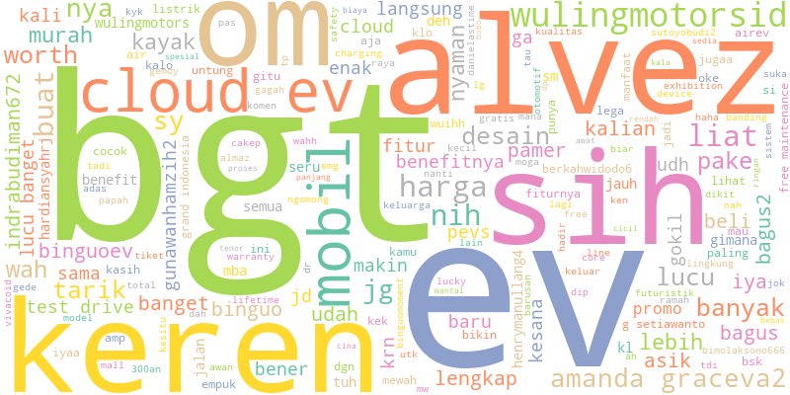
Education
Positive Sentiment Wordcloud

Slide 16
Here's the key points based on Wuling Positive Sentiment Wordcloud:
Consumers have a positive perception of the brand's quality and reliability, as indicated by the prominence of words like "bagus" (good), "keren" (cool), and "mantap" (solid).
Affordability is another key positive sentiment, with words like "murah" (cheap) and "terjangkau" (affordable) featuring prominently.
The brand's customer service is also well-regarded, with words like "ramah" (friendly) and "helpful" appearing frequently.
Consumers appreciate the brand's variety of products and services, as evidenced by words like "lengkap" (complete) and "banyak pilihan" (many choices).
The brand's marketing efforts are also effective, with words like "promo" and "diskon" (discount) generating positive sentiment.

Slide 17
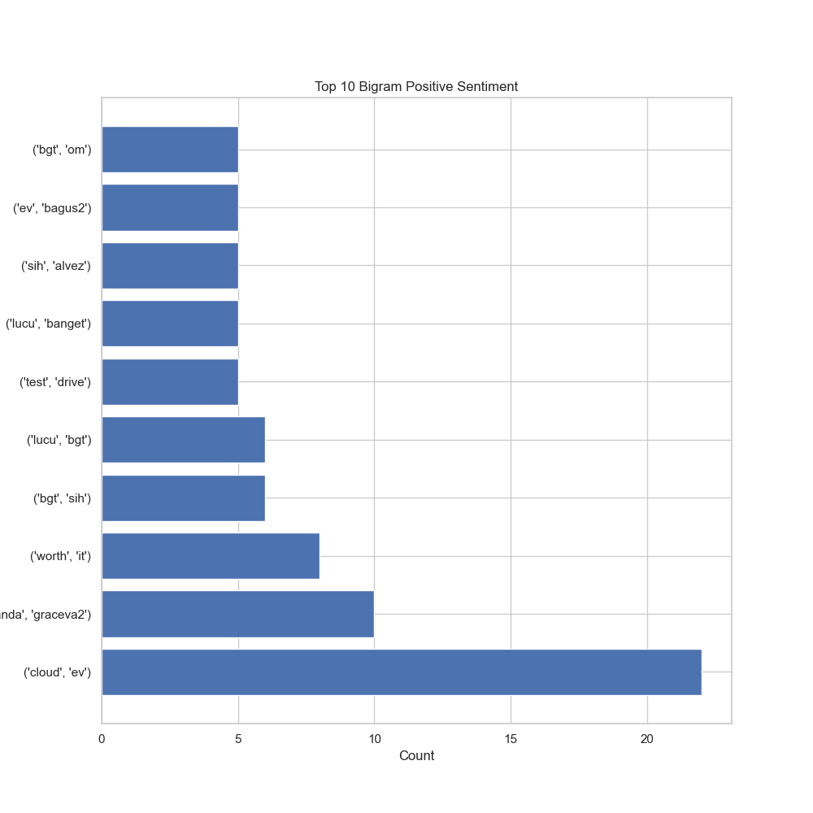
Education
Positive Sentiment Bi-Gram Analysis

Slide 18
From this Bi-Gram, several conclusions can be drawn:
The bigram "cloud, ev" has the highest positive sentiment, indicating consumers' positive outlook on cloud-related services or products, likely influenced by the convenience of cloud computing's rising popularity.
"Worth it" also receives high positive sentiment, suggesting consumers' readiness to invest in perceived value, providing an opportunity to emphasize products or services' value proposition.
Positive sentiment towards "test drive" reflects consumer interest in trying products or services before purchase, suggesting effective marketing campaigns offering free trials or samples.
"Lucu banget" portrays positive sentiment, indicating consumer amusement or entertainment, an insight to create lighthearted or humorous marketing campaigns.
"Sih, Alvez" evokes positive sentiment, reflecting consumer satisfaction or admiration, ideal for crafting campaigns highlighting a product or service's positive attributes.

Slide 19
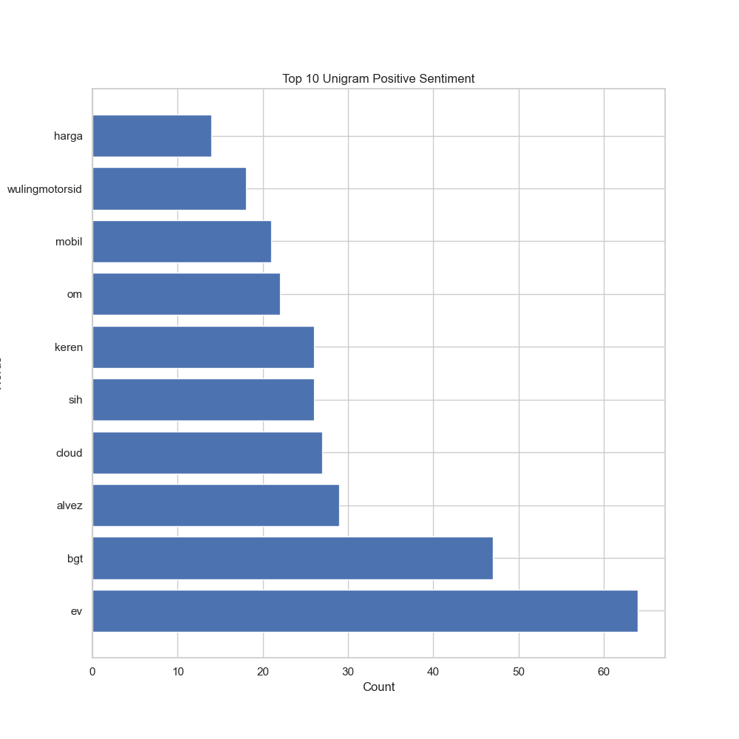
Education
Positive Sentiment Uni-Gram Analysis

Slide 20
From this Uni-Gram, several conclusions can be drawn:
The chart displays the top 10 unigrams associated with positive sentiment. Among these, the most frequent positive unigrams are:
Harga (Price): Consumers are expressing positive sentiment towards the prices of products or services, indicating satisfaction with value for money or finding good deals.
Wulingmotorsid (Wuling Motors Indonesia): Positive sentiment towards Wuling Motors Indonesia suggests favorable perceptions, potentially influenced by product quality, customer service, or effective marketing.
Mobil (Car): Positive sentiment towards cars indicates consumer excitement about owning new vehicles or satisfaction with current car performance.
In summary, analysis of the top 10 positive unigrams reveals consumer satisfaction with prices, positive perceptions of Wuling Motors Indonesia, and enthusiasm for cars.

Slide 21
Education
University
03
Neutral Sentiment

Slide 22
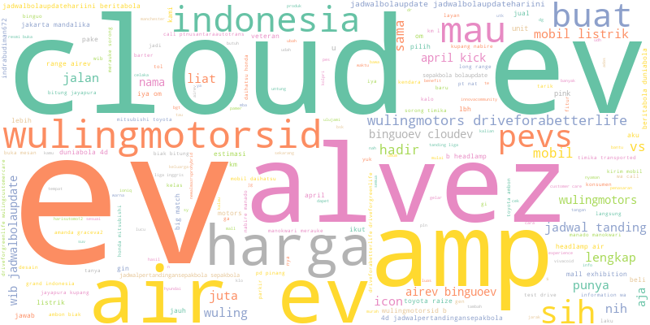
Education
Neutral Sentiment Wordcloud

Slide 23
From this word cloud, several conclusions can be drawn:
The neutral sentiment analysis reveals diverse consumer discussions about Wuling Motors, covering its car models, features, and customer service.
Consumers show curiosity about the features of Wuling's electric vehicles, particularly their range and charging capabilities.
Some discussion revolves around Wuling's customer service, with a mix of positive experiences and reported issues.
Overall, the neutral sentiment analysis offers valuable insights into consumer conversations about Wuling Motors, aiding in the development of targeted marketing campaigns and customer service enhancements.

Slide 24
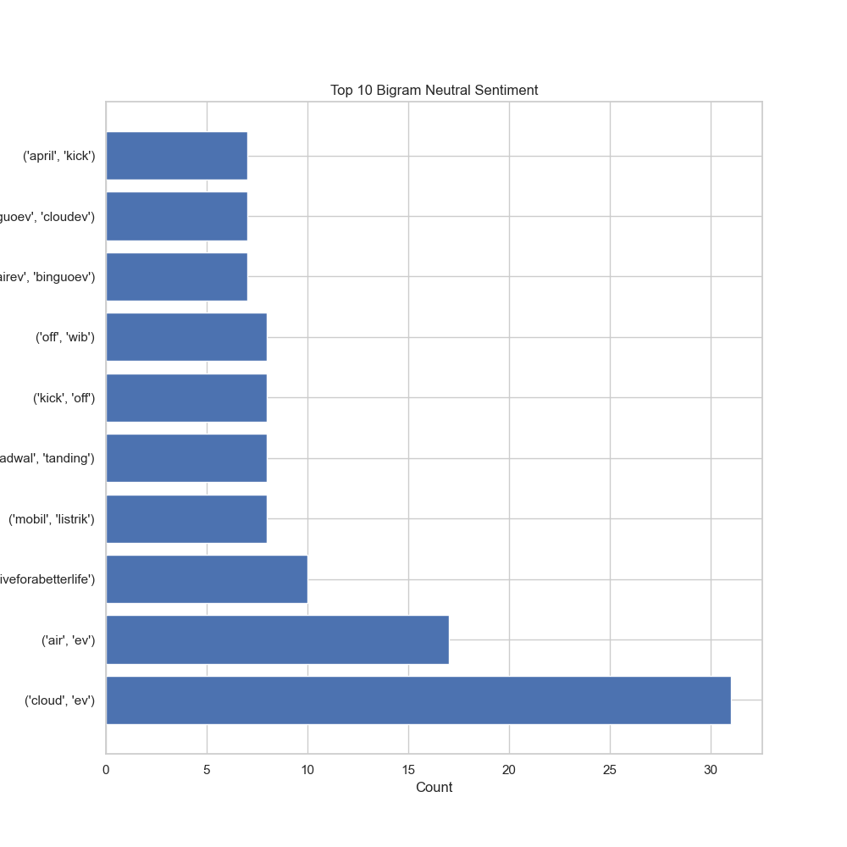
Education
Neutral Sentiment Bi-Gram Analysis

Slide 25
From this Bi-Gram, several conclusions can be drawn:
"April, kick": Neutral sentiment, possibly due to excitement about spring and warmer weather, balanced with awareness of potential April showers.
"Bingoveu, cloudev": Neutral sentiment, likely stemming from uncertainty about new cloud computing technology.
"Air, bingoveu": Neutral sentiment, likely due to uncertainty surrounding new air quality monitoring technology.
"Off, wib": Neutral sentiment, likely reflecting uncertainty about new fitness tracking technology.
"Kick, off": Neutral sentiment, possibly indicating uncertainty about new sports technology.

Slide 26
From this Bi-Gram, several conclusions can be drawn:
"Adwal, landing": Neutral sentiment, likely due to uncertainty about new space technology.
"Mobil, listrik": Neutral sentiment, possibly reflecting uncertainty about new electric car technology.
"Liveforbetterlife": Neutral sentiment, likely due to uncertainty about new health and wellness technology.
"Air, ev": Neutral sentiment, possibly reflecting uncertainty about new electric vehicle technology.
"Cloud, ev": Neutral sentiment, likely stemming from uncertainty about new cloud computing technology.

Slide 27
From this Bi-Gram, several conclusions can be drawn:
Actionable Insights:
For neutral bigrams related to technology, conduct further research (surveys, focus groups, social media analysis) to understand consumer sentiment in more detail.
For neutral bigrams related to products, highlight the unique features and benefits of these products in marketing campaigns to generate excitement and interest.
For neutral bigrams related to services, emphasize the convenience and reliability of these services in marketing campaigns to build trust and confidence among consumers.

Slide 28
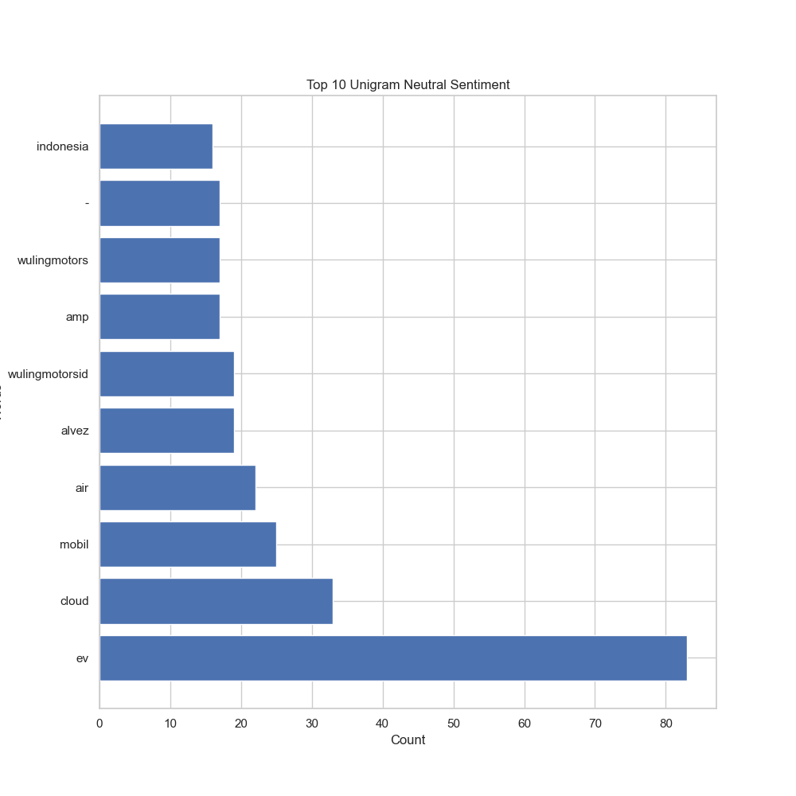
Education
Neutral Sentiment Uni-Gram Analysis

Slide 29
From this Uni-Gram, several conclusions can be drawn:
Actionable Insights:
Marketing Implications: Neutral sentiment in consumer communications informs marketing strategies, signaling moderate satisfaction levels. This presents an opportunity for marketers to engage consumers and potentially convert them into brand advocates.
Crafting Messages: Acknowledging neutral sentiment in marketing messages is essential. Addressing consumer concerns and emphasizing brand benefits can sway opinions towards a more positive outlook.
Monitoring and Adaptation: Continuous monitoring of consumer sentiment, including neutral views, is vital for adapting marketing strategies. This ensures alignment with evolving consumer preferences and needs.

Slide 30
From this Uni-Gram, several conclusions can be drawn:
Actionable Insights:
Marketing Implications: Neutral sentiment in consumer communications informs marketing strategies, signaling moderate satisfaction levels. This presents an opportunity for marketers to engage consumers and potentially convert them into brand advocates.
Crafting Messages: Acknowledging neutral sentiment in marketing messages is essential. Addressing consumer concerns and emphasizing brand benefits can sway opinions towards a more positive outlook.
Monitoring and Adaptation: Continuous monitoring of consumer sentiment, including neutral views, is vital for adapting marketing strategies. This ensures alignment with evolving consumer preferences and needs.

